Slide 1
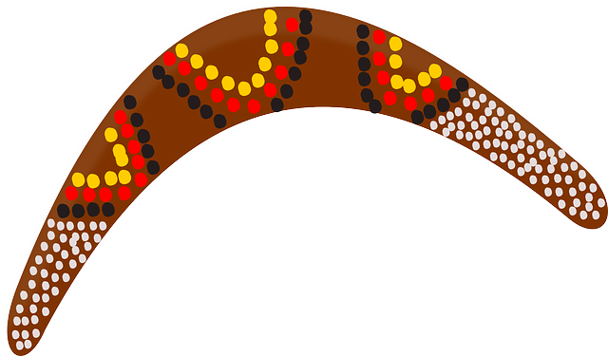
Aboriginal Dreamtime Stories
Year 9

Slide 2
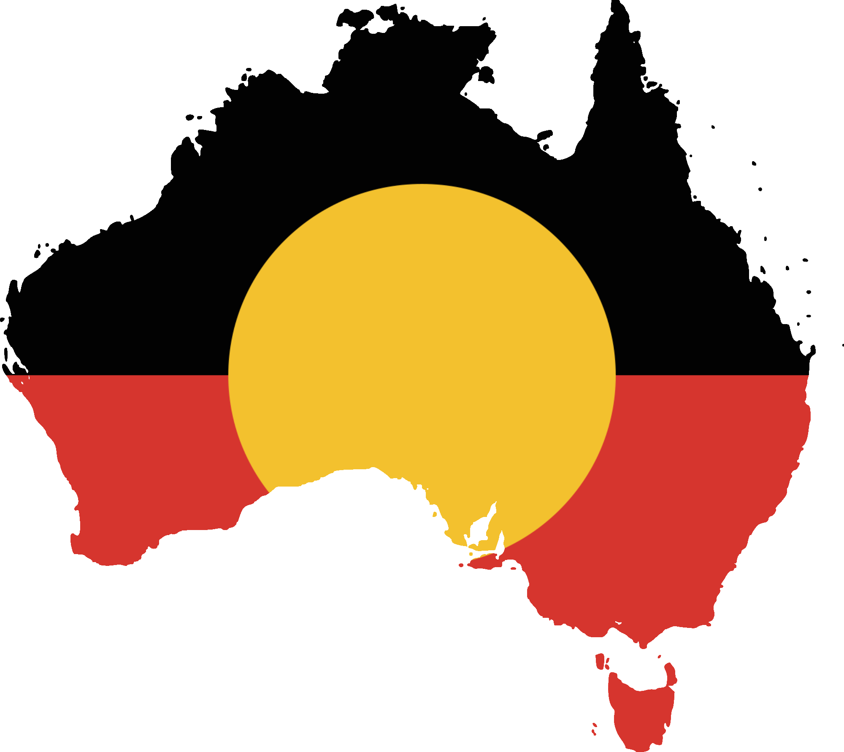
Learning Intentions
To understand the significance of myths and symbolism in Aboriginal Dreamtime Stories.
To identify and describe Aboriginal dreamtime stories.
Success Criteria
I can discuss the significance of Aboriginal Dreamtime and identify at least 2 Dreamtime stories.

Slide 3
Aboriginal Dreamtime
The Dreamtime describes important features of Aboriginal spiritual beliefs and existence. Aboriginals believe that the Dreamtime was way back, at the very beginning. The land and the people were created by the Spirits. They made the rivers, streams, water holes, the land, hills, rocks, plants and animals. The Aboriginals believed that the entire world was made by their Ancestors way back in the very beginning of time, the Dreamtime. The Ancestors made everything.

Slide 4
Explaining the Dreamtime
https://www.youtube.com/watch?v=J4rAa6PReQM&feature=youtu.be

Slide 5
Aboriginal Dreamtime Summary
Past, present and future – how things came to be.
The different stories that explain elements of creation – land, river, trees etc.
Everything comes from Country.

Slide 6
Dreamtime Stories - Mirram The Kangaroo and Warreen The Wombat
https://www.youtube.com/watch?v=xDJrnldb08o&list=PLscMLzWTKYcbzbNRz0xfj8VQgI5u5cATe&index=2

Slide 7
What we are looking at today:
Symbols
Myths

Slide 8
Symbols
The tradition of passing information through art has allowed customs and beliefs to continue over time for Aboriginal people. Aboriginal people do not have their own written language so they use many common symbols or iconography in their artwork to tell stories.
The presence of Australian Aboriginal Art can be found over 30,000 years ago. A very important aspect of this art is the use of symbols. The use of symbols is an alternate way to write down stories of cultural significance, teaching survival and use of the land.
Symbols are used by Aboriginal people in their art to preserve their culture and tradition. They are also used to depict various stories and are still used today in contemporary Aboriginal Art. These ancient symbols can be seen in their rock paintings, cave paintings, body paint, ceremonial clothing, and sand painting.

Slide 9
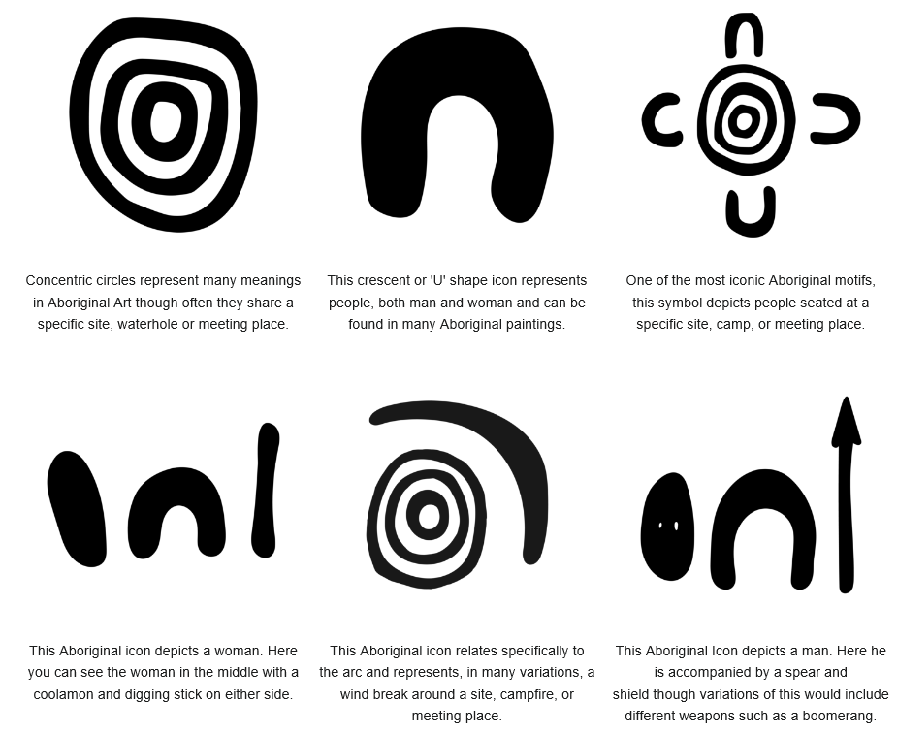

Slide 10
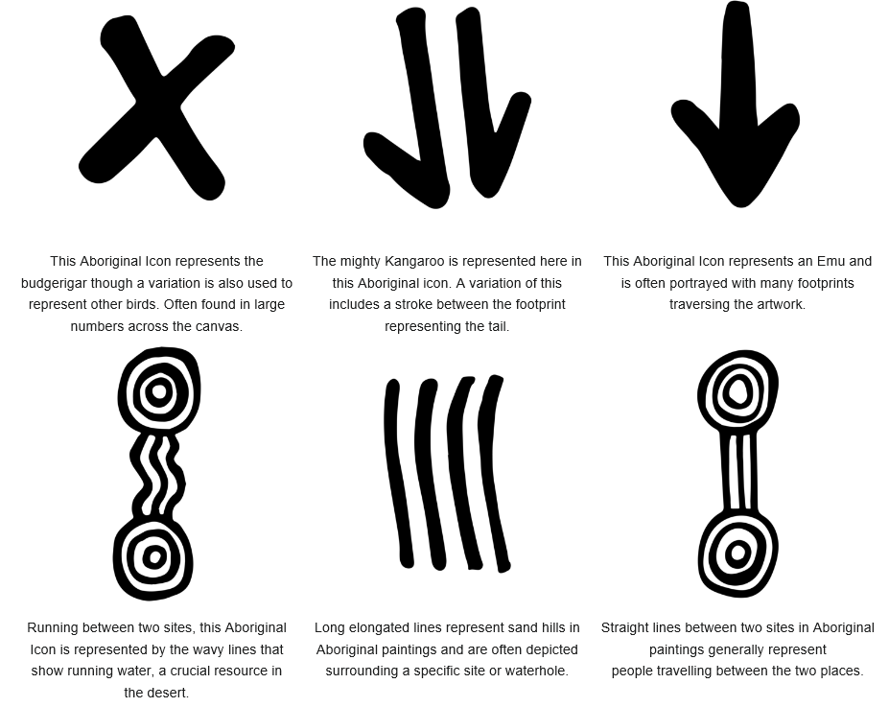

Slide 11
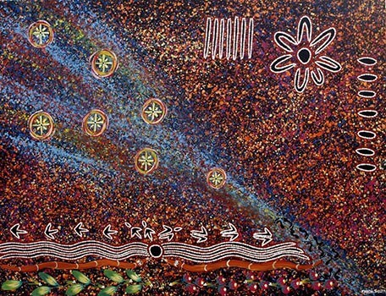
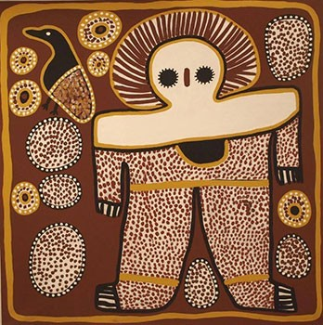
Aboriginal Art

Slide 12
Myths
Myths are stories that are based on tradition. Some may have factual origins, while others are completely fictional. But myths are more than mere stories and they serve a more profound purpose in ancient and modern cultures.

Slide 13
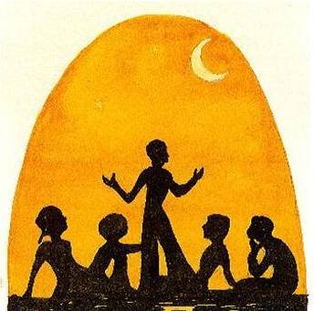
Myths in Aboriginal Culture
Australian Aboriginal mythology has survived tens of thousands of years. Considered one of the oldest surviving cultures on the planet, the Aborigines of Australia have been able to preserve their heritage over the course of 300 generations of oral history, art, and tradition. Here are a few of the stories which have stood the test of time.
The Aboriginal Dreamtime explores the myths and legends in Aboriginal culture.

Slide 14
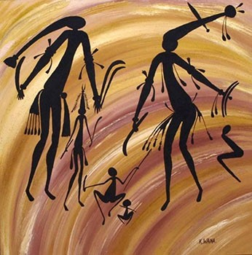
Aboriginal Dreamtime and Myths
The Aboriginals learned about their beginnings through their Dreamtime creation folklores that told of the momentous actions of the creators. The myths were the foundation of Aboriginal society and provided certainty about existence.
Aboriginal’s believed that the land they occupied was once not in existence like it is today. It was free from form or life, empty.
They unquestionably believed that this was the way things once were because the ancestors had said so and they would never doubt their word.

Slide 15
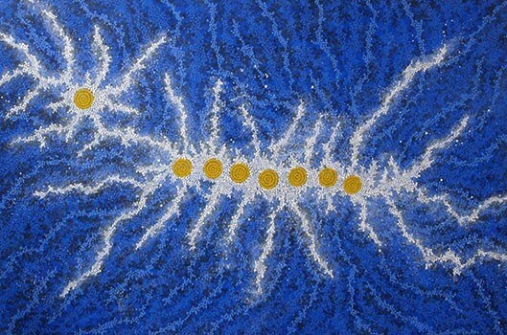
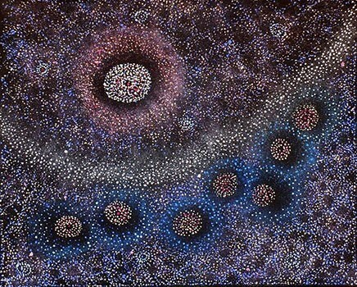
Dreamtime Continued
It was during what has become known as the Dreamtime, the land, mountains, hills, rivers, plants, lifeforms both animal and human and sky above were formed by the actions of mysterious and supernatural spirits.
During the Dreamtime the creators made men women and animals, declared the laws of the land and how people were to behave to one another, the customs of food supply and distribution, the rituals of initiation, the ceremonies of death which are required to be performed so that the spirit of the dead travels peacefully to his or her spirit-place, and the laws of marriage.

Slide 16
Dreamtime Stories
https://www.greatvaluevacations.com/travel-inspiration/australian-aboriginal-mythology

Slide 17
Reflection – Success Criteria
3 things you have learnt about Aboriginal culture
2 Dreamtime stories
1 purpose of a Dreamtime story

